Slide 1
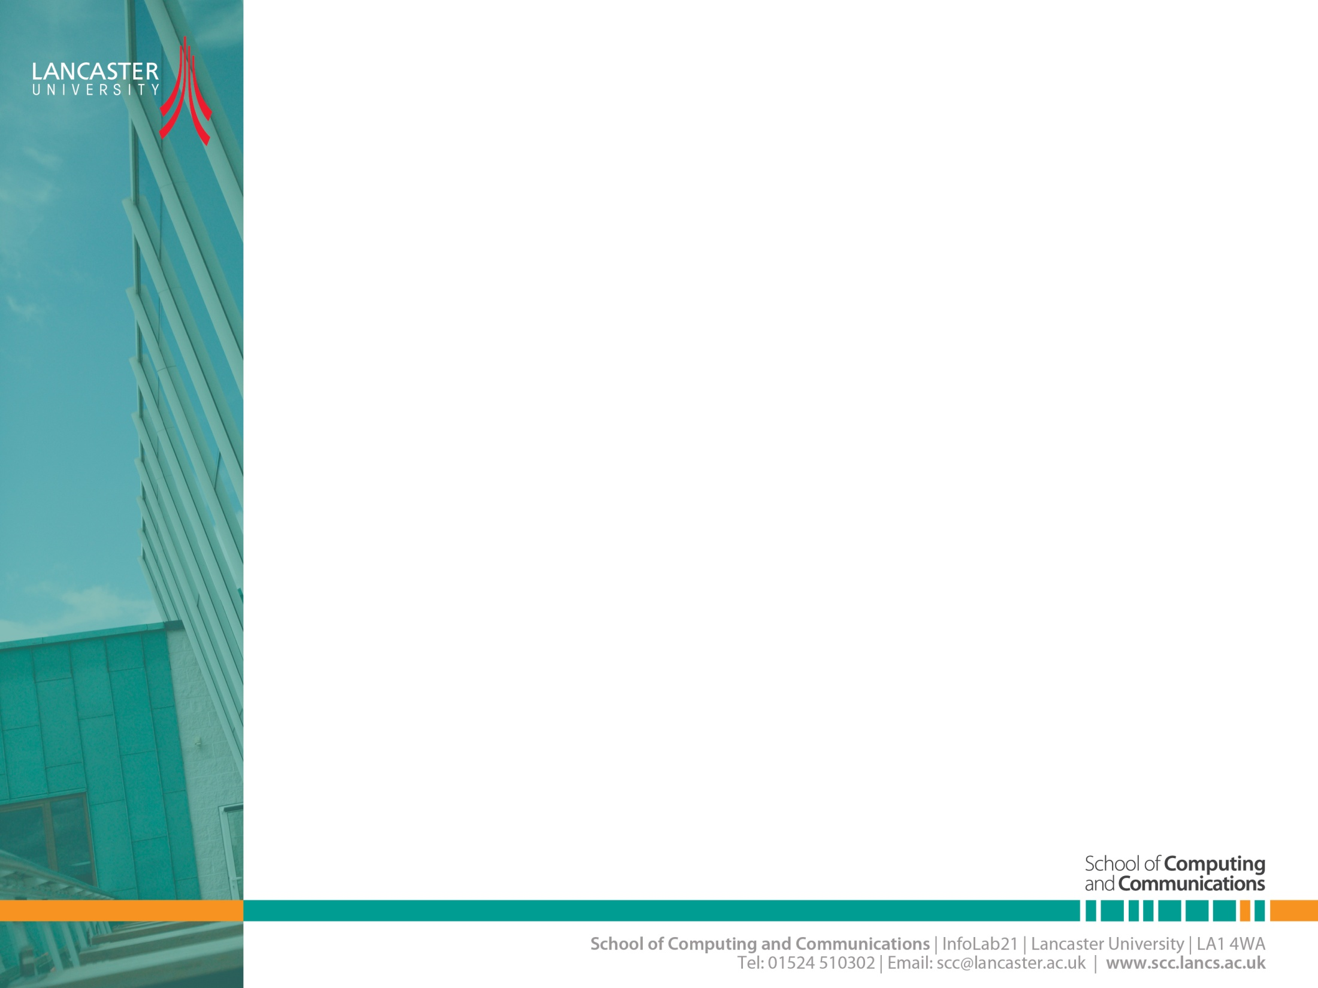

Wireless Channel Modelling-2
CNSCC.405
Digital Signal Processing
Dr Muhammad Abrar (Dr. MAB)
m.abrar@lancaster.ac.uk

Slide 2
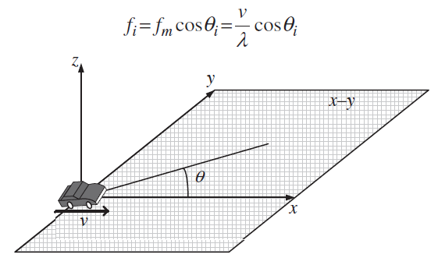

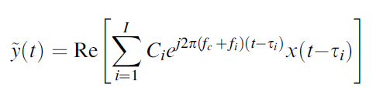



Statistical Characterization of Fading Channel
baseband transmit signal
passband
transmit signal
Clarke’s proposed model
channel gain
delay
Doppler shift

Slide 3

Over Multipath channel subject to numerous scattering components, follows the Rayleigh distribution.
If some of the scattering components are much stronger than most of the components or have LOS component, the fading process no longer follows the Rayleigh distribution.
In the case , the amplitude of the received signal, follows the Rician distribution and thus, this fading process is referred to as Rician fading.

Slide 4
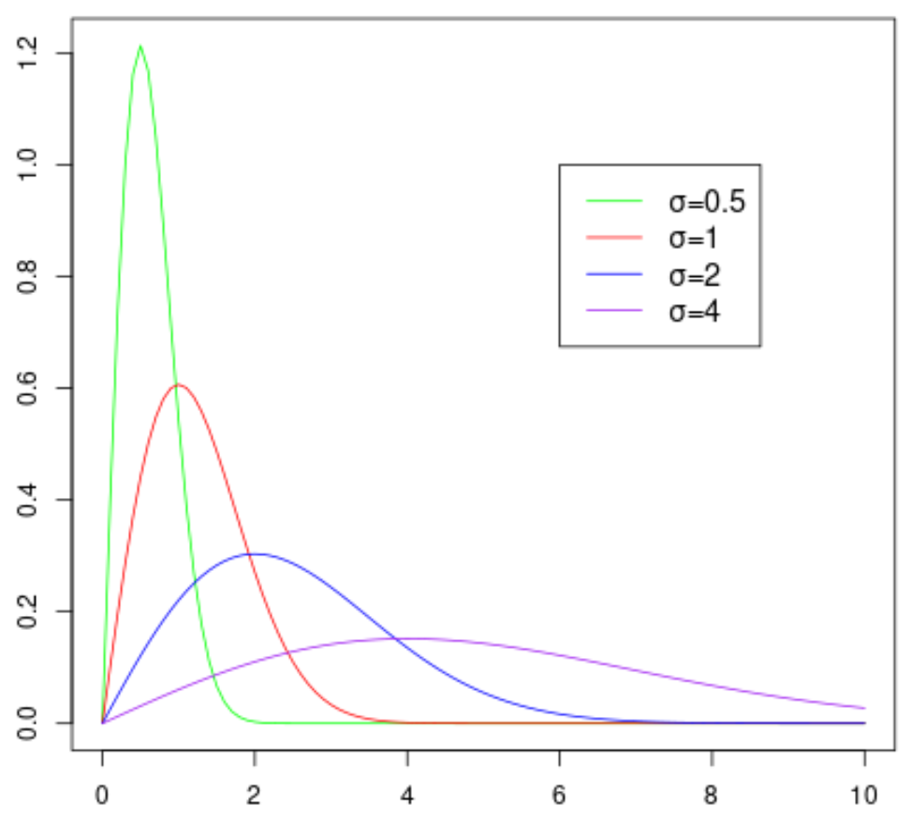
Rayleigh Distribution
The Rayleigh distribution is a continuous probability distribution used to model random variables that can only take on values equal to or greater than zero.
It has the following probability density function:
f(x; σ) = (x/σ²)e^{-x2/(2σ2)}
where σ is the scale parameter of the distribution.
The Rayleigh Distribution has the following properties:
Mean: σ√π/2 = 1.253σ
Variance: ((4-π)/2)σ² = 0.429σ²
Mode: σ
Note that the larger the value for the scale parameter σ, the wider the distribution becomes.

Slide 5
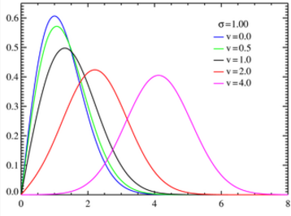

Rician distribution
A Rice or Rician distribution (also known as a Nakagami-n distribution) is one way to model the paths scattered signals take to a receiver.
FM radio waves, microwaves, MRI images in the presence of noise, and satellite transmissions.
The distribution also models Rician fading, which is a way to show how signal cancellations affect radio propagation.
I0(z) is a modified Bessel function of the first kind with order zero.

Slide 6
Rayleigh and Rician fading channels
Rayleigh and Rician fading channels are useful models of real-world phenomena in wireless communications.
These phenomena include multipath scattering effects, time dispersion, and Doppler shifts that arise from relative motion between the transmitter and receiver.

Slide 7
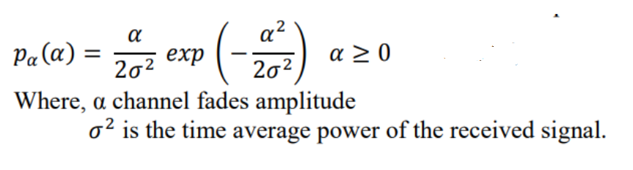
Rayleigh Fading
Rayleigh Distribution occurs when the envelope of the received signal follows a Rayleigh distribution.
Rayleigh distribution is statistically used to model a faded signal, when there is no dominant LOS path.
The envelope of the received signal with Rayleigh distribution has the probability density function (pdf) given by
The comulative distribution function (cdf) Rayleigh distribution is defined as:
Notes:
PDF is the probability that a random variable (let X), will take a value exactly equal to the random variable (X). CDF is the probability that a random variable (let X) will take a value less than or equal to the random variable (X).

Slide 8
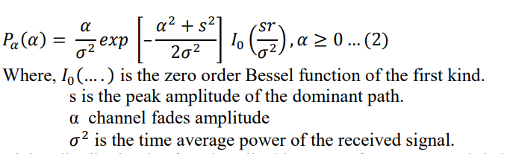
Rician Fading
The Rician distribution which also occurs as a result of multipath propagation is statistically used to model a distribution when a strong line of sight component is present along with the weaker components. It has the probability density function (pdf) given by
Rician distribution is often described in terms of a parameter, k, is known as the Rician factor and is expressed by
As s approaches 0, k approaches ∞ dB and as the dominant path decreases in amplitude, the Rician distribution degenerates to a Rayleigh distribution

Slide 9
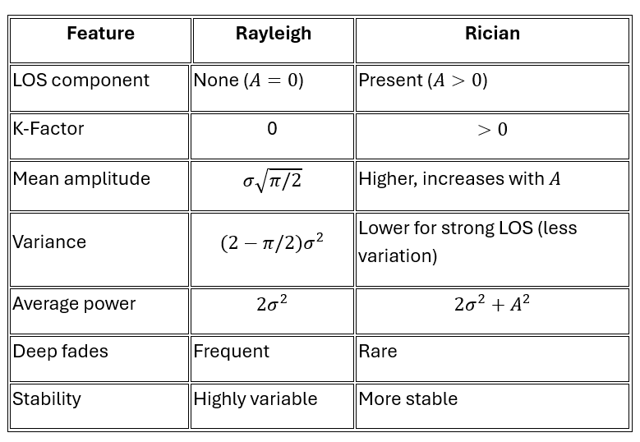
Key Comparison

Slide 10
Distributions for Rayleigh and Rician fading channels

Slide 11
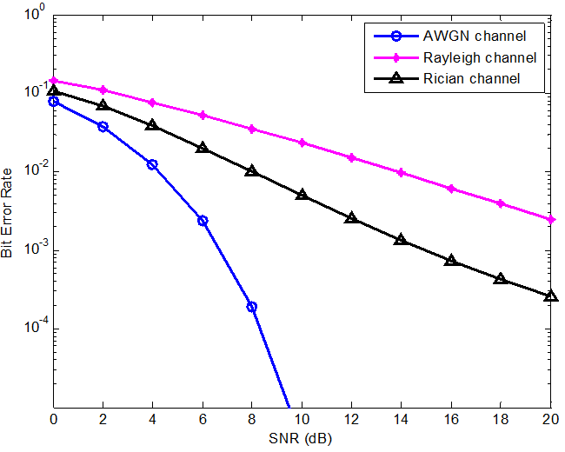
BER performance of BPSK in Rician, Rayleigh, and AWGN fading channels

Slide 12
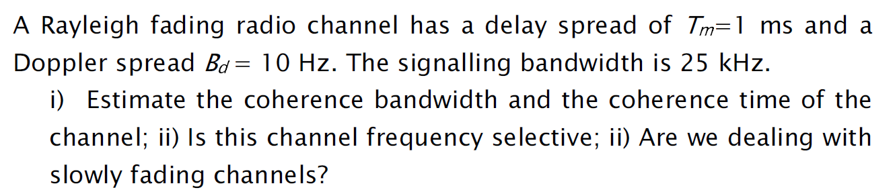
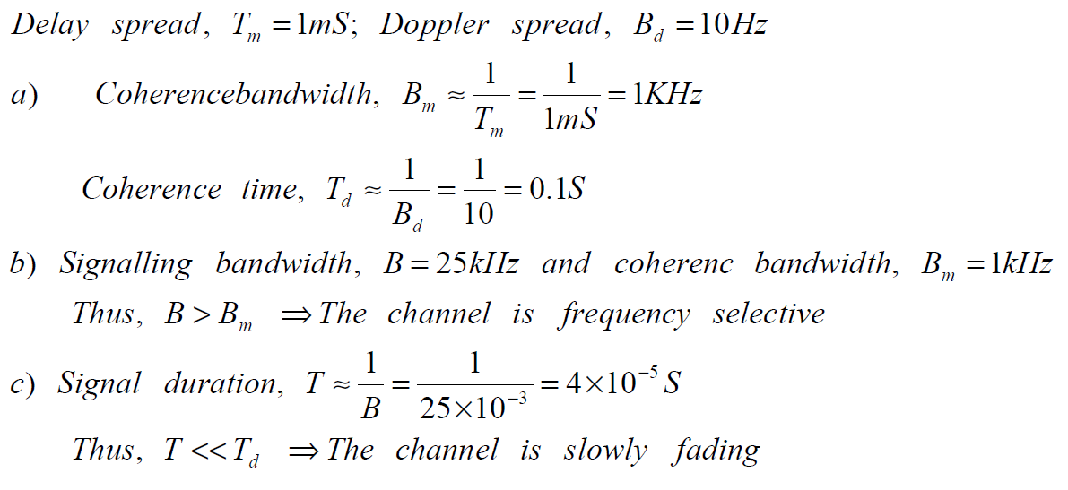
Example-1

Slide 13
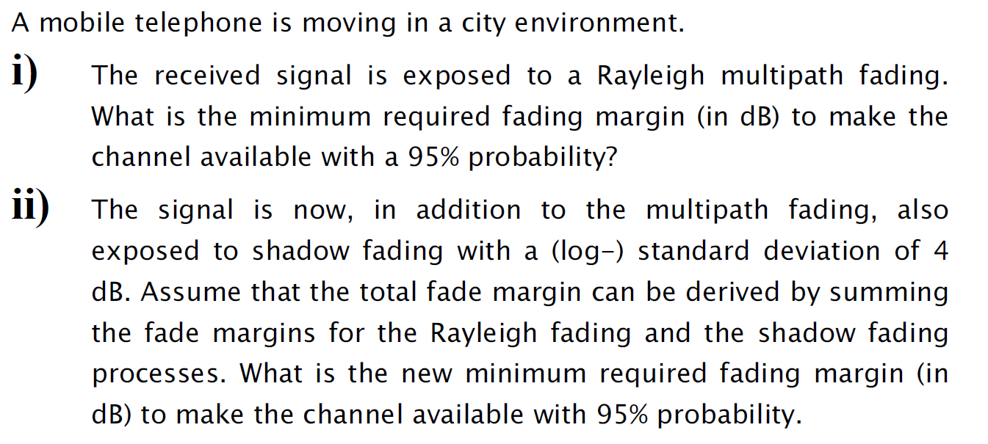
Example-2

Slide 14
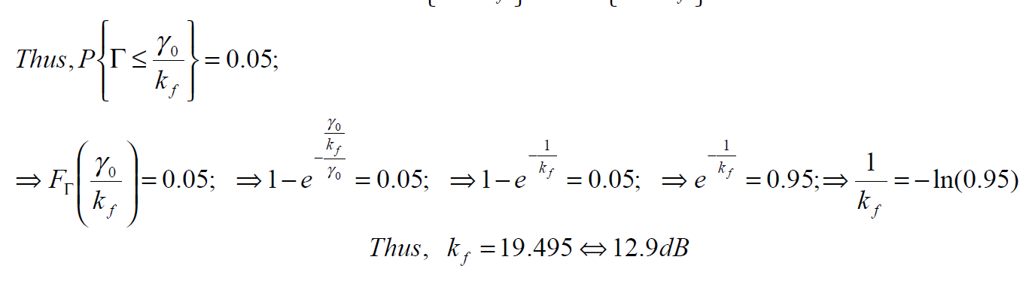
Solution

Slide 15
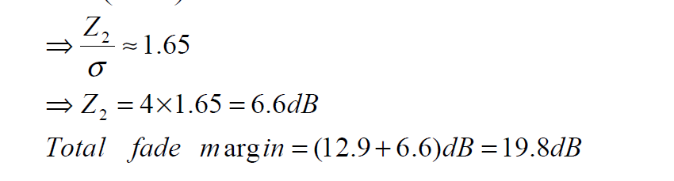

Slide 16
Example-3
A wireless signal is received via two paths. The main path has a delay of 1.2 μs, and a reflected path has a delay of 2.0 μs. The RMS Delay Spread (σ_{τ}) is approximately equal to the delay difference in this simple case. a) What is the approximate RMS Delay Spread? b) Calculate the Coherence Bandwidth (Bc) for a correlation of 0.9. c) Is the channel "flat" or "frequency selective" for a signal bandwidth of 500 kHz?

Slide 17
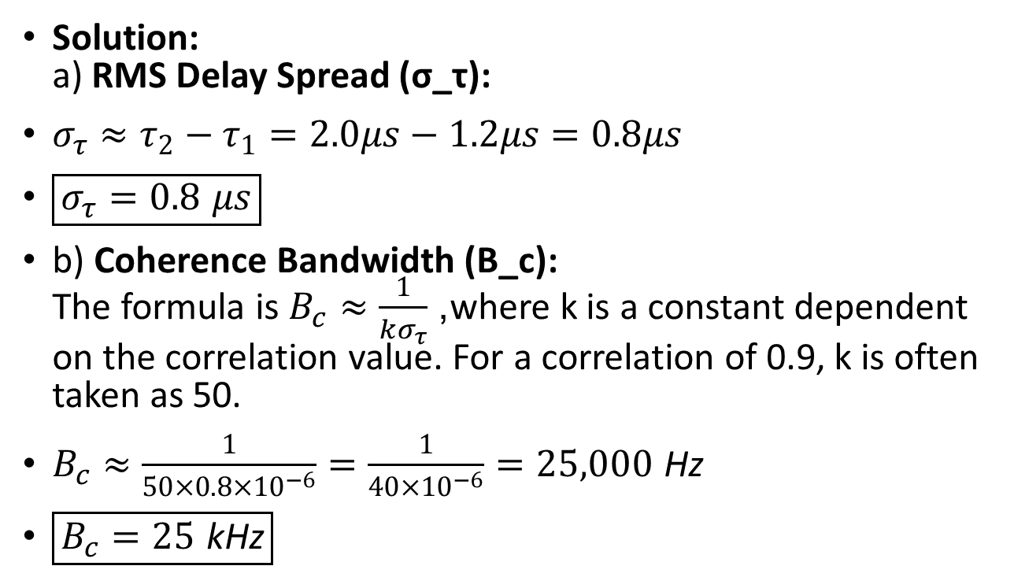
Solution
Solution: a) RMS Delay Spread (σ_τ):
$σ_{τ}≈τ_{2}−τ_{1}=2.0μs−1.2μs=0.8μs$
$\boxed{σ_{τ}=0.8 μs}$
b) Coherence Bandwidth (B_c): The formula is $B_{c}≈\frac{1}{kσ_{τ}}$, where k is a constant dependent on the correlation value. For a correlation of 0.9, k is often taken as 50.
$B_{c}≈\frac{1}{50×0.8×{10}^{−6}}=\frac{1}{40×{10}^{−6}}=25,000 \text{Hz}$
$\boxed{B_{c}=25 \text{kHz}}$

Slide 18
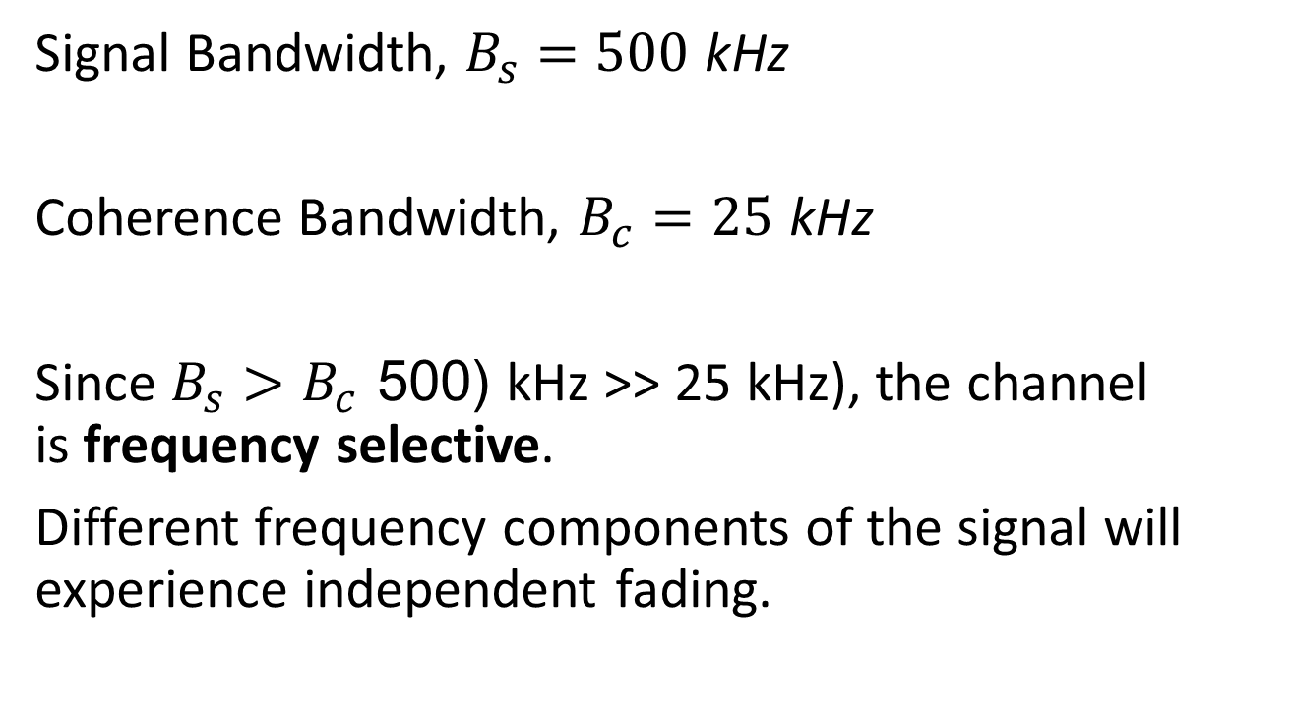
c) Channel Classification:
Signal Bandwidth, $B_{s}=500 \text{kHz}$
Coherence Bandwidth, $B_{c}=25 \text{kHz}$
Since $B_{s}>B_{c}$ (500 kHz >> 25 kHz), the channel is frequency selective.
Different frequency components of the signal will experience independent fading.

Slide 19
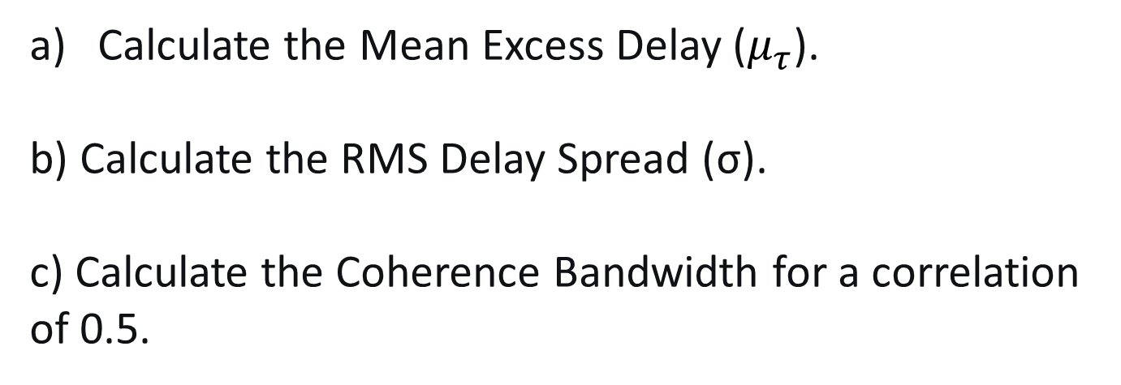
Example-4 :
A channel has a power delay profile (PDP) with three paths:
Path Number | Delay (μs) | Power (W)
1 | 0 | 0.5
2 | 1 | 0.3
3 | 3 | 0.2
Calculate the Mean Excess Delay ($μ_{τ}$).
b) Calculate the RMS Delay Spread (σ).
c) Calculate the Coherence Bandwidth for a correlation of 0.5.

Slide 20
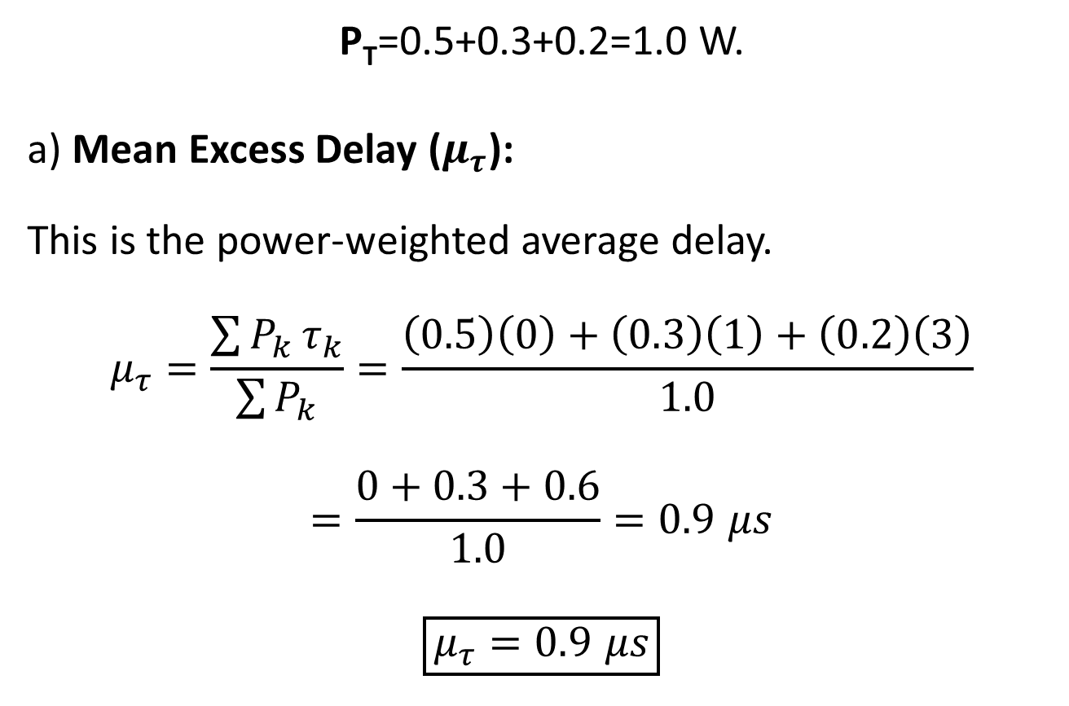
Solution
P_{T}​=0.5+0.3+0.2=1.0 W.
a) Mean Excess Delay ($μ_{τ}$):
This is the power-weighted average delay.
$$μ_{τ}=\frac{\sum{P_{k}}τ_{k}}{\sum{P_{k}}}=\frac{\left(0.5\right)\left(0\right)+\left(0.3\right)\left(1\right)+\left(0.2\right)\left(3\right)}{1.0}$$
$$=\frac{0+0.3+0.6}{1.0}=0.9 μs$$
$$\boxed{μ_{τ}=0.9 μs}$$

Slide 21
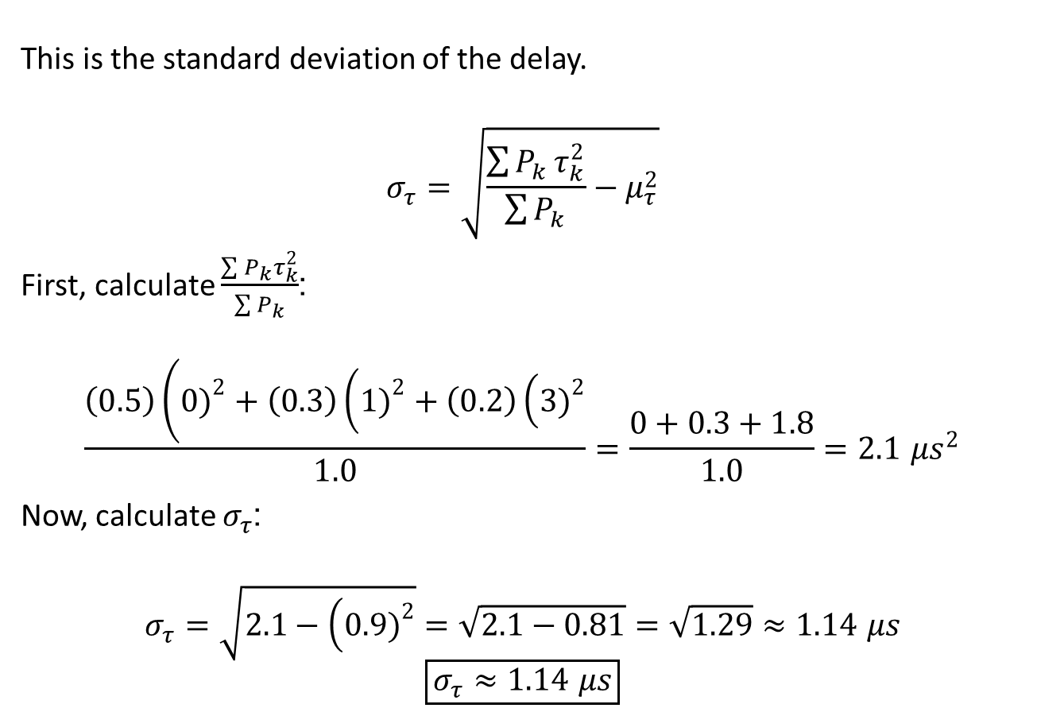
b) RMS Delay Spread (σ_{τ}):
This is the standard deviation of the delay.
$$σ_{τ}=\sqrt{\frac{\sum{P_{k}}τ_{k}^{2}}{\sum{P_{k}}}−μ_{τ}^{2}}$$
First, calculate $\frac{\sum{P_{k}}τ_{k}^{2}}{\sum{P_{k}}}$:
$$\frac{\left(0.5\right)\left(0{\left.)\right.}^{2}+\left(0.3\right)\left(1{\left.)\right.}^{2}+\left(0.2\right)\left(3{\left.)\right.}^{2}\right.\right.\right.}{1.0}=\frac{0+0.3+1.8}{1.0}=2.1 μs^{2}$$
Now, calculate $σ_{τ}$:
$$σ_{τ}=\sqrt{2.1−\left(0.9{\left.)\right.}^{2}\right.}=\sqrt{2.1−0.81}=\sqrt{1.29}≈1.14 μs$$
$$\boxed{σ_{τ}≈1.14 μs}$$

Slide 22
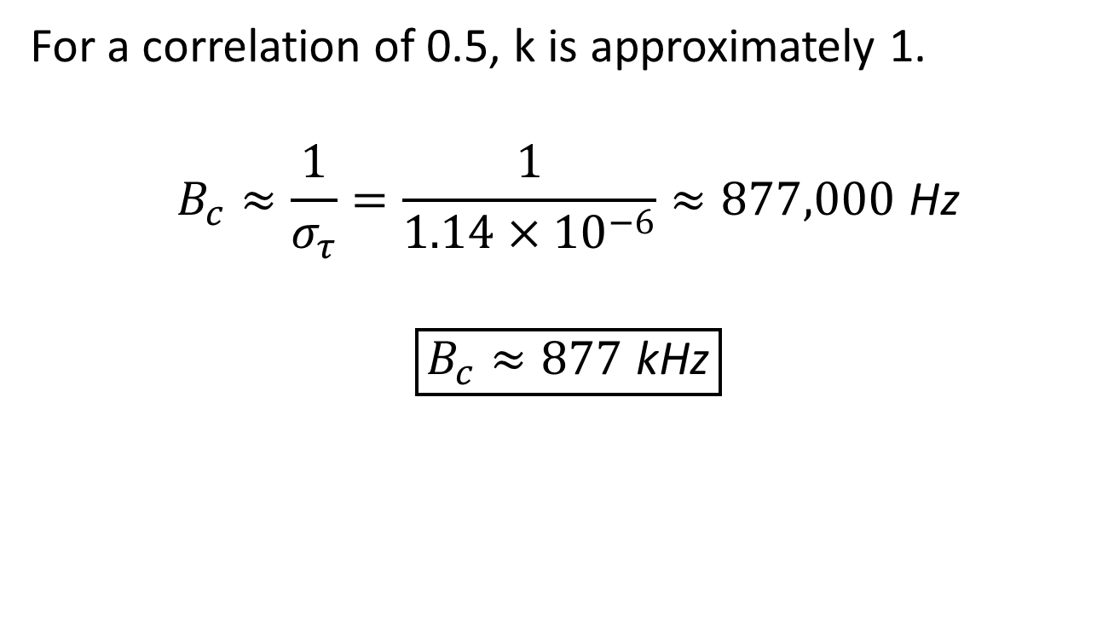
c) Coherence Bandwidth (B_{c})
For a correlation of 0.5, k is approximately 1.
$$B_{c}≈\frac{1}{σ_{τ}}=\frac{1}{1.14×{10}^{−6}}≈877,000 \text{Hz}$$
$$\boxed{B_{c}≈877 \text{kHz}}$$

Slide 23
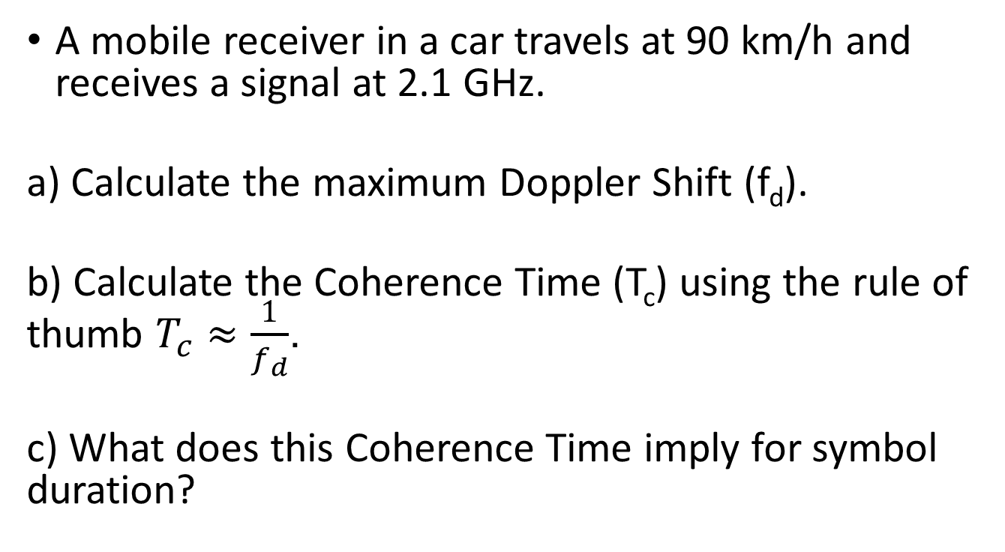
Example-5
A mobile receiver in a car travels at 90 km/h and receives a signal at 2.1 GHz.
a) Calculate the maximum Doppler Shift (f_{d}).
b) Calculate the Coherence Time (T_{c}) using the rule of thumb $T_{c}≈\frac{1}{f_{d}}$.
c) What does this Coherence Time imply for symbol duration?

Slide 24
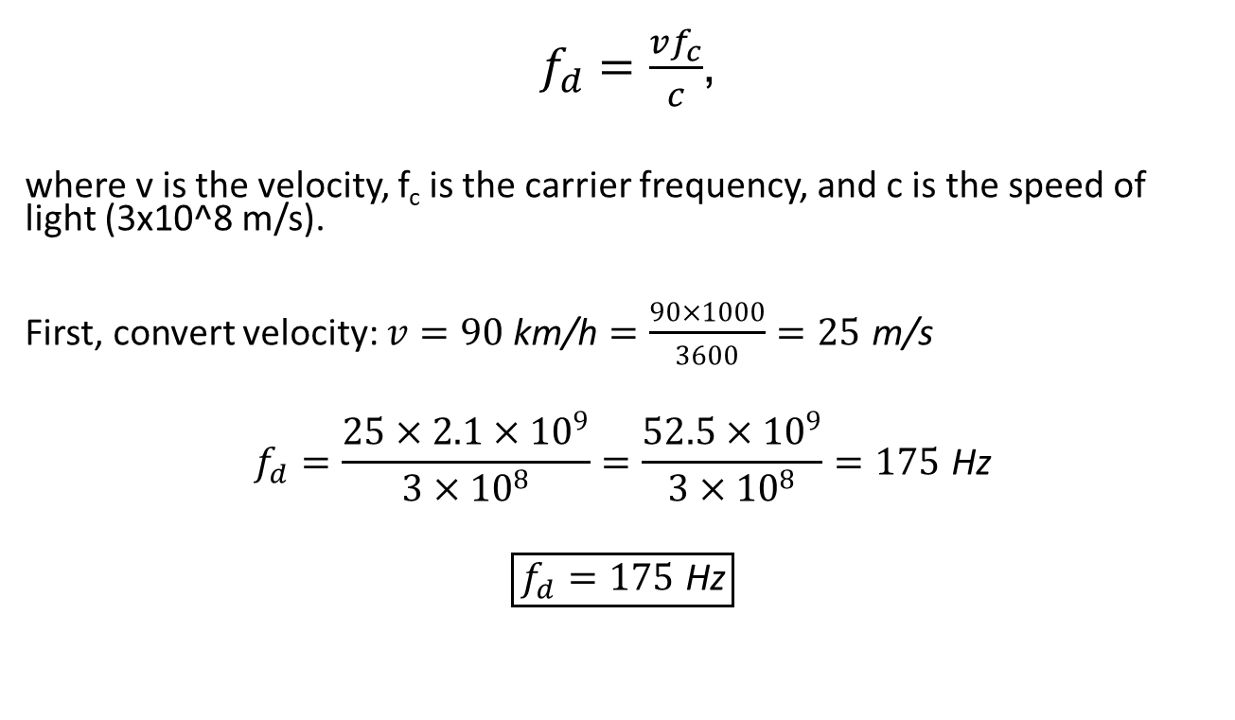
a) Maximum Doppler Shift (f_{d}):
$f_{d}=\frac{vf_{c}}{c}$,
where v is the velocity, f_{c} is the carrier frequency, and c is the speed of light (3x10^8 m/s).
First, convert velocity: $v=90 \text{km}\text{/}\text{h}=\frac{90×1000}{3600}=25 \text{m}\text{/}\text{s}$
$$f_{d}=\frac{25×2.1×{10}^{9}}{3×{10}^{8}}=\frac{52.5×{10}^{9}}{3×{10}^{8}}=175 \text{Hz}$$
$$\boxed{f_{d}=175 \text{Hz}}$$

Slide 25

b) Coherence Time (T_{c}):
Using the rule of thumb:
$$T_{c}≈\frac{1}{f_{d}}=\frac{1}{175}≈5.7 \text{ms}$$
$$\boxed{T_{c}≈5.7 \text{ms}}$$

Slide 26
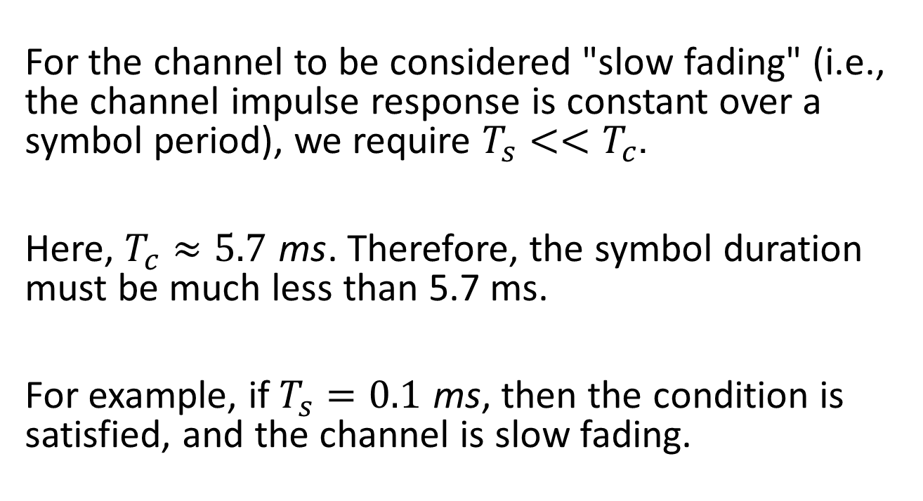
c) Implication for Symbol Duration (T_{s}):
For the channel to be considered "slow fading" (i.e., the channel impulse response is constant over a symbol period), we require $T_{s}<<T_{c}$.
Here, $T_{c}≈5.7 \text{ms}$. Therefore, the symbol duration must be much less than 5.7 ms.
For example, if $T_{s}=0.1 \text{ms}$, then the condition is satisfied, and the channel is slow fading.

Slide 27
Example-6
In a wireless channel measurement, the received signal envelope is analyzed.
Scenario A: The channel has a strong, constant Line-of-Sight (LOS) component with power = 8 units, and several scattered paths with total power = 2 units.
Scenario B: The channel has no LOS component, only many scattered paths with total power = 10 units.
a) Calculate the K-factor for Scenario A.
b) Classify the fading in Scenario A and Scenario B.

